Slide 1
Cayuse Activity Code Clarifications
UNM predominantly codes as “Research” or “Other”
Use the CFDA Program Code to determine if Research is applicable (at CFDA.gov)
Code as “Instruction/ Training” only when the Sponsor is funding for-credit courses, which is very rare
Do not code as “Fellowship”; this option will be deleted soon
Fellowships are primarily for Research
Contact your CGA in OSP if in doubt
Select the appropriate Activity Code on your Cayuse submittals

Slide 2
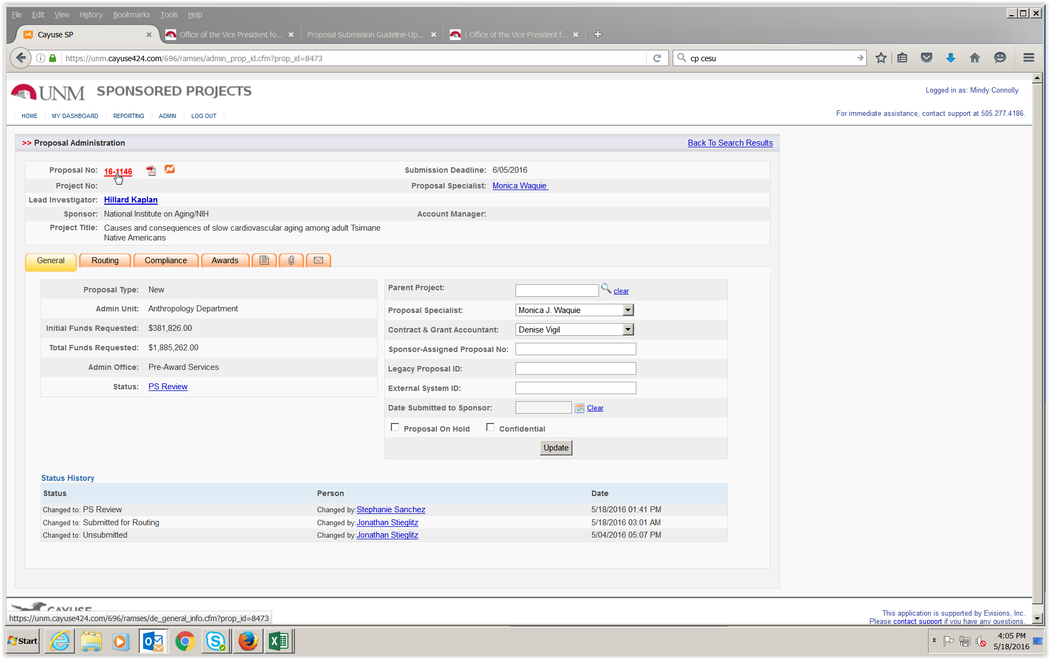
To Enter the Activity Code:
Go into the Proposal, from the Proposal Administration screen.

Slide 3
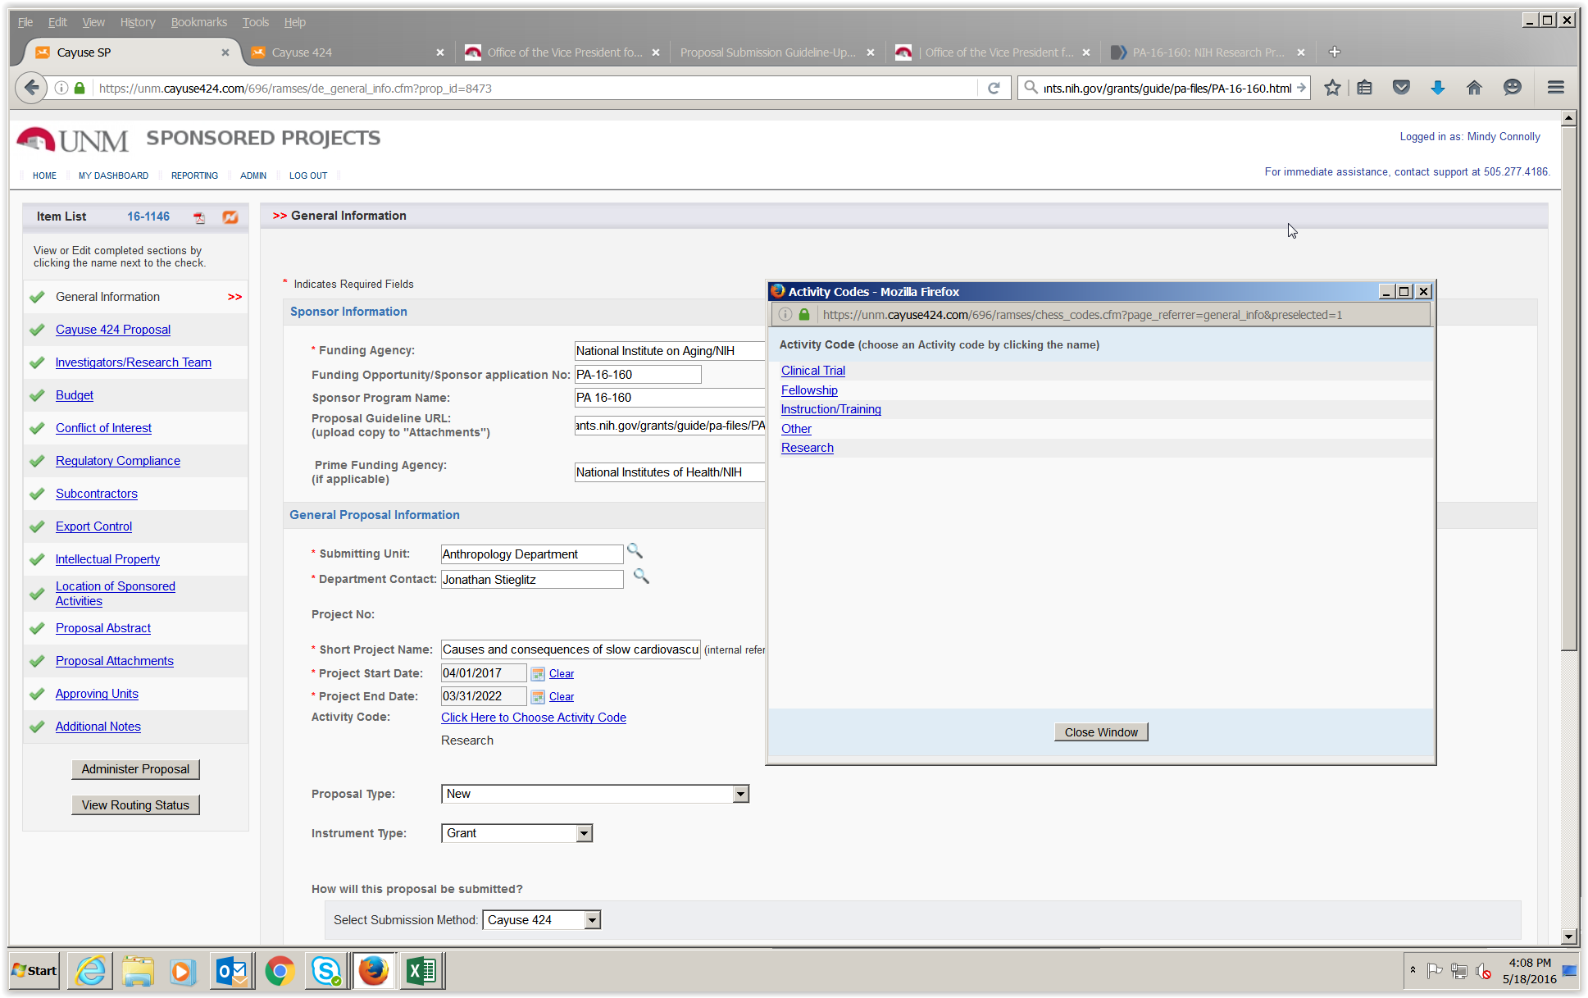
Select the Activity Code
2) Click on “Click here to Choose Activity Code”, then select the appropriate Activity code (Research or Other).
Reminder: Instruction/ Training is only used for sponsored for-credit courses.

